Slide 1

E-Pharmacy Management
Harmi Mathukiya - 21104044
Atharva Mohape - 21104121
Sana Khan - 21104068
Project Guide
Prof. Mansi Choche

Slide 2
Contents
Introduction
Objectives
Scope
Features / Functionality
Project Outcomes
Technology Stack
Block Diagram/ Flow

Slide 3
1. Introduction
Problem Identified :
Difficulty to find medicines from medicals during emergency.
Solution Proposed :
E-Pharmacy Management is a healthcare platform where you can immediate into medical shops in your vicinity.

Slide 4
2. Objectives
To manage the details of medicines, stocks, medicals, etc.
To built at administrative end and thus only the administrator is guaranteed access.
To built an application program to tackle one’s emergency situation.

Slide 5
3. Scope
The scope of pharma services is high in the healthcare, medical, and marketing sectors so this can be applied in Medical shops.
Here they can note the list of their medicines required which stores in a table.
Manage their current stock and Update & Delete it.
Users will be helped to search there needed medicine.

Slide 6
4. Feature /Functionality
For accessing, one has to Sign In and Sign Up.
Multiple medicines can be added.
Medicines can be deleted and updated.
Different Profile Section has been created.
Updated medicals and medicines are listed on the search page.
Expiry dates for medicines can also be checked.

Slide 7
5. . Outcome of Project
User can Search for Medicine.
Medicines can be added and updated and it includes information such as name of the medicine, Description, Price, Expiry and Quantity of that particular medicine.
We have created different profile sections for both admin and customer.
E-pharmacy can have sufficient order management systems in place to process order or delete and update.

Slide 8



6. Technology Stack
Python
Tkinter
MYSQL

Slide 9
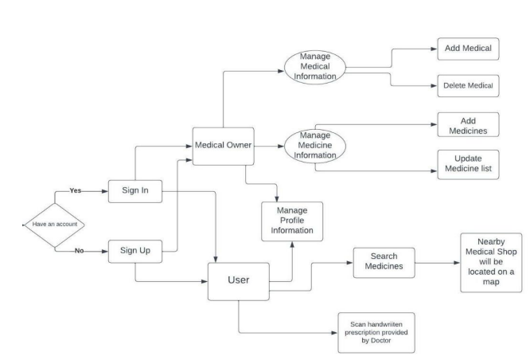
7. Block Diagram/ Flow Chart

Slide 10
Thank You...!!

